Slide 1
Chapter 3 The Judicial System

Slide 2
Parties in the Judicial System
Plaintiffs
Initiate the lawsuit
Called petitioners in some cases
Defendants
Alleged to have violated some right of the plaintiff
Party named in the suit for recovery

Slide 3
Parties in the Judicial System
Lawyers
Those who act as advocates for plaintiffs and defendants
Have fiduciary relationship with clients
Represent client and see that procedures are followed
Privilege exists with client
Must keep what client tells them confidential
Exception is advance notice of crime to be committed

Slide 4
Parties in the Judicial System
Judges:
Can control proceedings or outcomes
Can be elected or appointed
Trial or Appellate
Trial Judge presides over trial
Appellate Judge hears appeal from trial court

Slide 5
Jurisdiction
Jurisdiction is the Authority of a Court to Hear a Case
Types of Jurisdiction:
Subject matter jurisdiction is jurisdiction over the subject matter of the case
Personal jurisdiction is jurisdiction over the parties in a case

Slide 6
Types of Courts
Trial Courts
Place where case begins
Jury hears cases and decides disputed issues of fact
Single judge presides over case
Appellate Courts
Review actions of trial court
Usually have published opinions for uniformity and consistency
No trials held - panel of judges hears case

Slide 7
How Courts Make Decisions
Process of Judicial Review (Appellate)
Determine whether error was made
Transcript is reviewed
All other evidence is reviewed
Parties submit written briefs to summarize the evidence and issues

Slide 8
How Courts Make Decisions
Process of Judicial Review (Appellate)
Oral arguments may be made before panel of judges
Generally three judges, but at U.S. Supreme Court level it is nine
En banc : full bench hears case
Judges vote on whether there is reversible error
Error that might have affected the outcome

Slide 9
How Courts Make Decisions
Process of Judicial Review (Appellate)
Possible actions of reviewing court
Affirm—no reversible error and decision stands
Reverse—reversible error and decision is reversed
Remand—error that requires further proceedings
Modify—change ruling of lower court

Slide 10
How Courts Make Decisions
Process of Judicial Review
Judicial review and case precedent—the doctrine of stare decisis
Courts will follow previous decisions for consistency
Previous decisions are called precedent

Slide 11
How Courts Make Decisions
Process of Judicial Review
Exceptions to stare decisis—when precedent may not be followed
Cases are factually distinguishable
Precedent is from another jurisdiction or lower court
Technology changes
Sociological, moral, or economic changes

Slide 12
Parties in the Judicial System
Name Changes for Parties on Appeal
Appellant or Petitioner: Party appealing the lower court’s decision
Appellee or Respondent: Party who won below and is not appealing

Slide 13
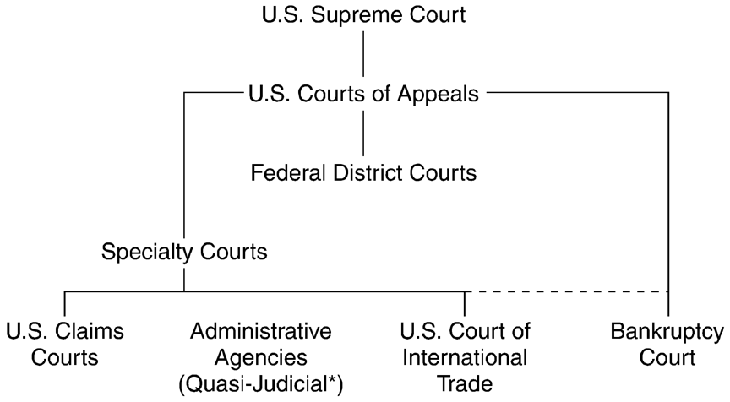
Federal Court System

Slide 14
Federal Court System
Federal District Court
General trial court of the federal system
Subject matter jurisdiction
When U.S. is a party
Federal question
Diversity of citizenship
Citizens 2 or more states, plaintiff seeking $75,000 or greater

Slide 15
Federal Court System
Federal District Court
One issue that arises is what law will be applied to the case
Federal courts apply state law, they do not make up a new system of federal common law
There are ninety-seven federal districts
Each state is at least one federal district
Number of districts per state is determined by population and case load

Slide 16
Federal Court System
Federal District Court Opinions
Opinions are reported in the Federal Supplement
Cite: F.Supp. (F.Supp.2d.)
Example: Gratz v. Bollinger, 135 F.Supp.2d 790 (E.D.Mich. 2001)

Slide 17
Federal Court System
Specialized Courts—Courts of Limited Original Jurisdiction
Tax court
Bankruptcy court
Claims Court
Judge Advocate General (military courts)
Courts for other agencies
Court of International Trade

Slide 18
Federal Court System
Court of Appeals
Formerly known as U.S. Circuit Court of Appeals
Thirteen federal circuits
Generally a panel of three judges reviews appeals from Federal District Court
Opinions found in Federal Reporter
Cite: F., F.2d or F.3d.
Elk Grove Unified School District v. Newdow, 292 328 F.3d. 466 (C.A. 9 2003)

Slide 19
Federal Court System
Supreme Court
Must decide to review and hear a case
Issues writs of certiorari on those cases they will review-determined by the rule of four
Has original jurisdiction for:
Disputes between and/or among states

Slide 20
Federal Court System
Supreme Court
Nine judges with lifetime appointments
Opinions reported in:
United States Reports—official reports
Gratz v. Bollinger, 539 U.S. 244 (2003), 156 L. Ed. 2d. 257 (2003), 123 S. Ct. 2411 (2003)

Slide 21

State Court Systems

Slide 22
State Court Systems
General Trial Court
Usually called superior, circuit, district, or county court
Opinions reported in regional reporters.
Example: Pacific Reporter, P. or P.2d.
Opinions also reported in state reporters
Example: 45 Wash.App. 442, 725 P.2d 1022 (1986)

Slide 23
State Court Systems
Lesser Courts
Small claims: Lesser damage claims, often no lawyer
Traffic courts : For citations
Probate courts : For wills, guardianships, conservatorships, etc.

Slide 24
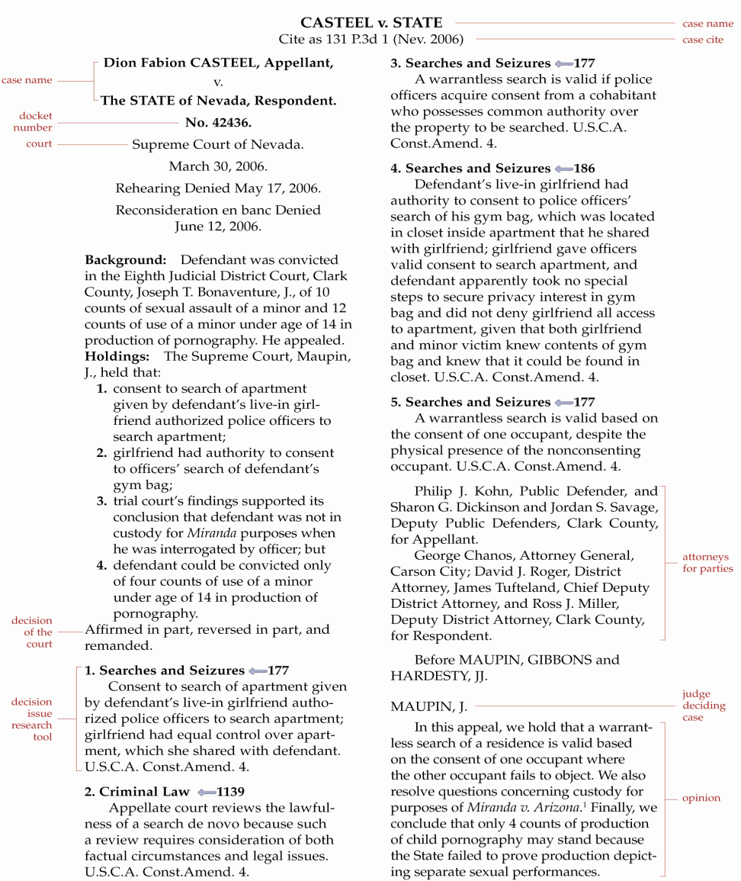
Sample Page of a National Reporter Case

Slide 25
Court Systems
Venue: Location of court
Venue in criminal cases can change from location of crime to another court if press coverage is excessive.
Civil venue is often the most geographically appropriate locale, or where defendant resides or where the cause of action occurred.
Standing: A plaintiff must have suffered a legal injury and have a sufficient “stake” in the controversy.

Slide 26
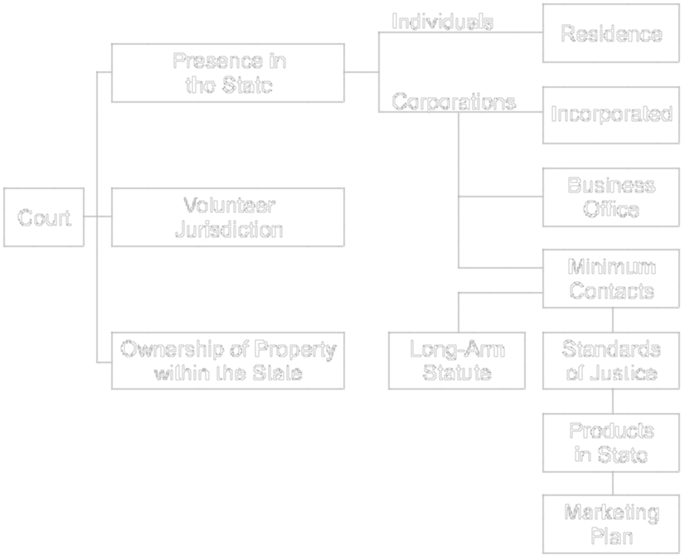
Personal Jurisdiction

Slide 27
In Personam Jurisdiction
Means for Acquiring Jurisdiction
Property ownership in the state = in rem jurisdiction
Volunteer—parties agree to it
Presence in the state
Residence
Corporations incorporated or doing business in the state
Minimum contacts - constitutional standards of contact with a state (“Long-Arm” Statutes)

Slide 28
Minimum Contacts and Long-Arm Statutes
Lindgren v. GDT, LLC (2004)
How much of a presence did each of the companies have in states other than their home states?
What happens if the defendant is not required to come to Iowa to defend the suit?
What role does the Internet business model play in minimum contacts?
3-27

Slide 29
Following a State Court Case
The Pleadings.
The Plaintiff’s Complaint and Summons
The Defendant’s Answer and Defenses.
Motion to Dismiss.
28
Notes:
28

Slide 30
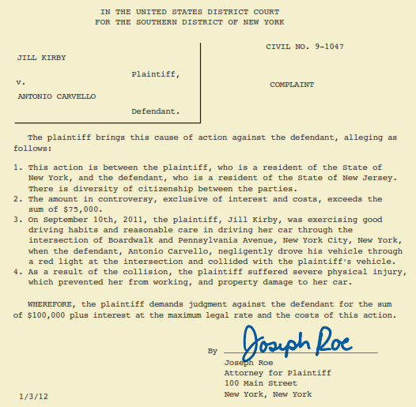
The Pleadings
Plaintiff’s Complaint.
Court acquires jurisdiction over subject matter and Plaintiff.
Facts: What happened.
Prayer: Court relief.
29
Notes:
29

Slide 31
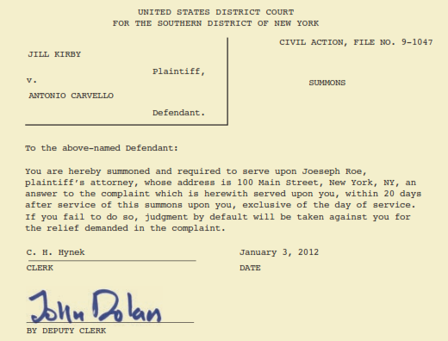
The Pleadings
Service of Process.
Plaintiff serves Defendant with Complaint and Summons. →
Default Judgment for Plaintiff if Defendant does not Answer.
30
Notes:
30

Slide 32
The Pleadings
Defendant’s Answer.
The Answer is the Defendant’s response to the allegations stated in the Plaintiff’s Complaint.
In the Answer, the Defendant must specifically admit or deny each allegation in the Complaint.
31
Notes:
31
5

Slide 33
The Pleadings
Defendant’s Answer:
May make General Denial.
May move for Change of Venue.
May allege Affirmative Defenses.
May assert Counterclaims against Plaintiff.
32
Notes:
32
5

Slide 34
Following a State Court Case
Discovery.
Process by which parties obtain information from the opposing party prior to trial.
Interrogatories: written questions and answers under oath.
Requests for Production:
Records, statements, photographs, contracts, memos, email, phone records, medical reports, etc.
33
Notes:
33

Slide 35
Following a State Court Case
34
Discovery.
Depositions: sworn testimony recorded and transcribed by court official reporter outside court.
Notes:
34

Slide 36
Following a State Court Case
35
Pretrial Conference.
Jury Selection.
Voir Dire.
Jurors can be dismissed peremptorily (no reason) limited or for cause (bias) unlimited.
Notes:
35

Slide 37
Following a State Court Case
36
The Trial.
Opening Statements.
Rules of Evidence.
Judge decides what evidence is admissible for jury’s consideration.
Evidence must be relevant to the issues (tends to prove or disprove).
Notes:
36

Slide 38
Following a State Court Case
37
The Trial:
Burden of Proof on Plaintiff
Evidence presented:
-Tangible evidence
-Witness Testimony
-Expert Witness. Provide specialized knowledge and opinions that help jurors decide issues.
Notes:
37

Slide 39
Following a State Court Case
38
Closing Arguments: each attorney summarizes the evidence and tells the client’s story in the most compelling way possible.
Jury Instructions
Verdict: The verdict specifies the jury’s findings and liability. A jury can award money damages in a civil case.
Notes:
38

Slide 40
Following a State Court Case
39
The Appeal.
A party may appeal the jury’s verdict or any legal issue, motion or court ruling during the trial.
Appellants must have legitimate grounds for appeal (usually legal error).
Notes:
39

Slide 41
Following a State Court Case
40
The Appeal.
Appellate Review: Typically appeals court affirms (agree with) or reverses (disagree with) the lower court’s decision.
Higher Appellate Courts.
Notes:
40

Slide 42
Following a State Court Case
41
Enforcing the Judgment.
Even if a plaintiff wins a jury award of damages, the defendant may not have sufficient assets or insurance to cover the amount.
Usually these factors are considered before a lawsuit is filed.
Notes:
41

Slide 43
Courts Adapt to the Online World
42
Electronic Filing.
Courts Online (websites, court dockets).
Cyber Courts and Proceedings.
Notes:
42

Slide 44
Alternative Dispute Resolution
43
Trials are a means of dispute resolution that are very expensive and sometimes take many months to resolve.
There are “alternative dispute resolution” (ADR) methods to resolve disputes that can be inexpensive, relatively quick and leave more control with the parties involved.
Notes:
43

Slide 45
Alternative Dispute Resolution
ADR describes any procedure or device for resolving disputes other than the traditional judicial process.
Unless court-ordered, there is no record which is an important factor in commercial litigation due to trade secrets.
Most common: mediation, arbitration.
44
Notes:
44

Slide 46
Alternative Dispute Resolution
Mediation.
Mediator talks face-to-face with parties (who typically are in different adjoining rooms) to determine “common ground.”
Advantages: few rules, customize process, parties control results (win-win).
Disadvantages: mediator fees, no sanctions or deadlines.
45
Notes:
45

Slide 47
Alternative Dispute Resolution
Arbitration.
Parties agree to binding or non-binding.
Many employment contracts have binding arbitration clauses.
Settling of a dispute by a neutral 3rd party (arbitrator) who renders a legally-binding decision; usually an expert or well-respected government official.
46
Notes:
46

Slide 48
Alternative Dispute Resolution
Arbitration.
Advantages: streamlined process, quicker decision, private process, can be less expensive.
Disadvantages: private process, very difficult to overturn award (decision).
47
Notes:
47

Slide 49
Alternative Dispute Resolution
Arbitration.
Arbitration Clauses and Statutes.
Uniform Arbitration Act of 1955.
Federal Arbitration Act.
Issue of Arbitrability.
Mandatory Arbitration in the Employment Context.
48
Notes:
48

Slide 50
Alternative Dispute Resolution
49
Providers of ADR Services.
Non-profit organizations:
American Arbitration Association.
Better Business Bureau.
For Profit:
JAMS-ADR.com(Flash enabled).
Notes:
49

Slide 51
Alternative Dispute Resolution
50
Online Dispute Resolution.
Also called ODR.
Uses the Internet to resolve disputes.
Still in its infancy but is gaining momentum.
See, e.g., www.cybersettle.com .
Notes:
50

